Slide 1
Dedication to work – Only way to success
Unsuccessful
Incapable and no efforts
Capable but no efforts
Capable + efforts
Successful
Capable + efforts
Incapable + efforts
Capable or Incapable + no efforts
I CAN
I CAN NOT
Prof. Sanjeev Sharma, Director
National Institute of Ayurveda – Jaipur
E-mail – profsanjeevhp@gmail.com
Mob. 8290696996

Slide 2
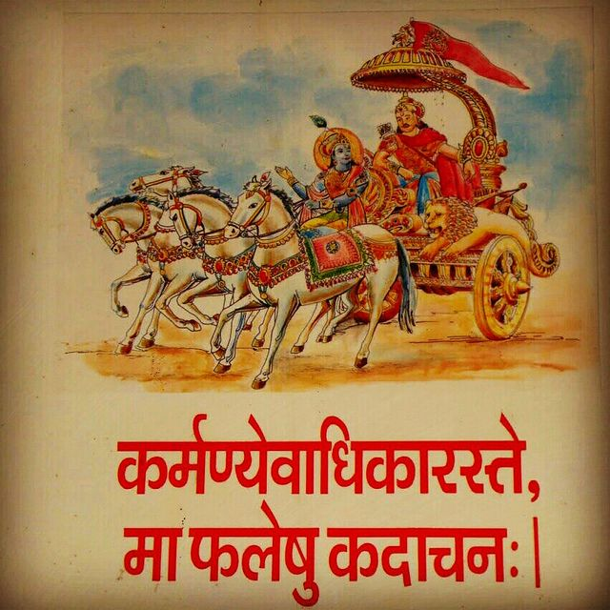

Slide 3
DEDICATION

Slide 4
DEDICATION
???
??????????

Slide 7
Dedication??
Committing yourself for something, some person or some cause

Slide 8
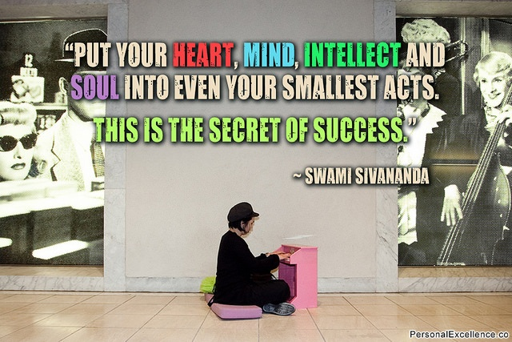

Slide 9
Success??
You achieved What you wanted

Slide 10
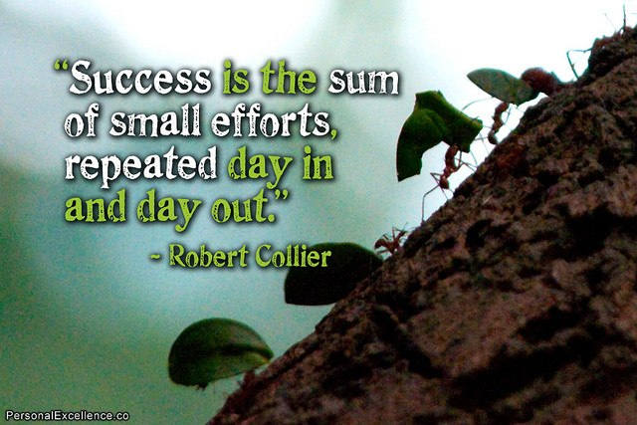

Slide 11
Success??
Success does not mean the absence of failures; it means the attainment of ultimate objectives.
It means winning the war not every battle.

Slide 12
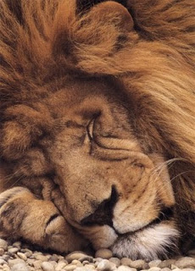
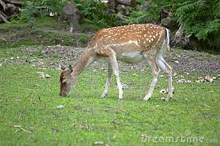
उद्यमेन हि सिध्यन्ति कार्याणि न मनोरथैः । न हि सुप्तस्य सिंहस्य प्रविशन्ति मुखे मृगाः ।।
यथा ह्येकेन चक्रेण न रथस्य गतिर्भवेत् । एवं पुरुषकारेण विना दैवं न सिध्यति ।।

Slide 13
Most of the people fail because….
Not due to the lack of ability or intelligence but because of lack of desire, direction, dedication, discipline, devotion and determination.

Slide 16
Attitude
The foundation of success, regardless of your chosen field, is attitude
Positive attitude always generates positive energy and that in turn produces better results
We can change the world with our positive attitude
Story of balloon seller

Slide 17
Factors that Determine your attitude
Environment
Experience
Education

Slide 18
How to change your attitude and become dedicated
Change Focus and look for the positive
Make a habit of doing it now
Develop an attitude of Gratitude
Get into a continuous education program
Build a positive self esteem
Stay away from negative influences
Learn to like the things that need to be done
Start your day with something positive

Slide 19
Success Mantras
Play to win and not to loose
Learn more from other people’s mistakes
Associate with people of high moral character
Give more than you get
Always think long term
Evaluate your strengths and build on them
Always keep large picture in mind while making decisions
Never compromise your integrity.

Slide 20
Motivation
Motivation means to encourage, inspire and ignite the spark for action

Slide 22
Motivation
Give recognition
Give respect
Make work interesting
Be a good listener
Encourage goal setting
Provide opportunities for growth
Provide training
Throw a challenge
Help, but don’t do for others what they should do for themselves

Slide 23
Self Esteem
confidence in one's own worth or abilities; self-respect.
Self-esteem is how we value ourselves; it is how we perceive our value to the world and how valuable we think we are to others. Self-esteem affects our trust in others, our relationships, our work – nearly every part of our lives.

Slide 24
High Self Esteem / Low Self Esteem
Talks about ideas Talk about People
Caring Attitude Critical Attitude
Humility Arrogance
Respects authority Rebels Authority
Confidence Confusion
Assertive Aggressive
Accepts responsibility Blames the whole world
Optimistic Fatalistic

Slide 30
Steps to Success
Dedicate yourself
Hard work
Mind set
Focusing
Motivation
Inspiration
Management
Utilising Potentials
Taking Risks

Slide 32
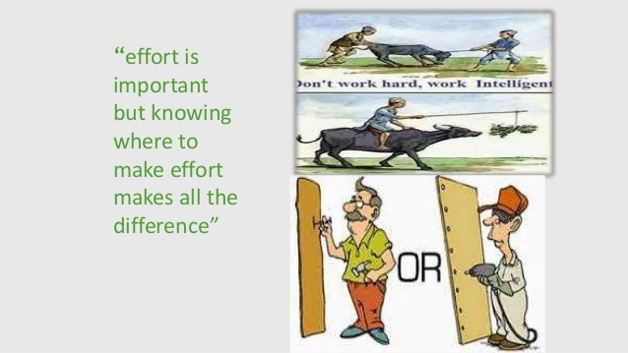

Slide 33
Carry Home Message
Start An Action Plan, Dedicate yourself and Define three things
What You want to achieve
How you expect to achieve it
When you want to achieve it

